Slide 1
9. Abstract Data Types
1.1–1.2
Notes:
(9.1a) Explain the meaning of data type.
(9.1b) Distinguish between objectand
(9.1c) Distinguish between primitive data types and object references.
(9.1d) Declare String variables and create String objects in a program.
(9.1e) Write code that manipulates/processes Strings by calling String methods. Do we want to refer them to the Java Reference Guide to limit the methods we are including in the course?
(9.1f) Explain the immutability of Strings.
(9.1g) Explain the results of concatenating Strings with primitive data types using the + operator.
(9.1h) Given a class API, write a client program that creates objects of that class and call methods defined for that class and illustrate the call stack and memory allocation for the execution of this client program.
(9.1i) Use the concepts of Object Oriented Programming (classes, objects, and methods) to write a program that solves a problem.

Slide 2
9. Abstract Data Types
Overview
Color
Image processing
String processing
Adopted and modified from Slides by Sedgewick and Wayne

Slide 3
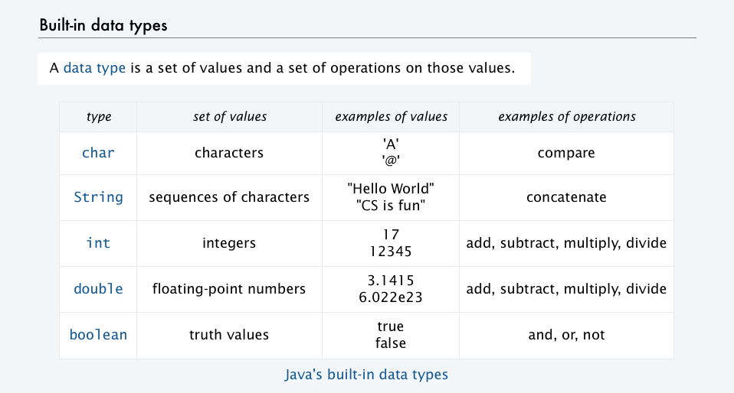
Abstract data types
Explain the meaning of data type.
LO 9.1a
A data type is a set of values and a set of operations on those values.
Primitive types
values immediately map to machine representations
operations immediately map to machine instructions.
We want to write programs that process other types of data.
Colors, pictures, strings,
Complex numbers, vectors, matrices,
...
An abstract data type is a data type whose representation is hidden from the client.

Slide 4

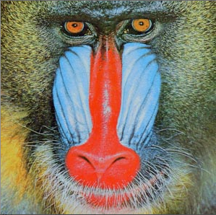
Object-oriented programming (OOP)
Object-oriented programming (OOP).
Create your own data types.
Use them in your programs (manipulate objects).
An object holds a data type value.
Variable names refer to objects.
Examples (stay tuned for details)
data type | set of values | examples of operations
Color | three 8-bit integers | get red component, brighten
Picture | 2D array of colors | get/set color of pixel (i, j)
String | sequence of characters | length, substring, compare
C | A | T | A | G | C | G | C
Best practice: Use abstract data types (representation is hidden from the client).
Impact: Clients can use ADTs without knowing implementation details.
This lecture: how to write client programs for several useful ADTs
Next lecture: how to implement your own ADTs

Slide 5

Using a data type: constructors and methods
To use a data type, you need to know:
Its name (capitalized, in Java).
How to construct new objects.
How to apply operations to a given object.
To construct a new object
Use the keyword new to invoke a constructor.
Use data type name to specify type of object.
new Building()
String s;
s = new String ("Hello, World");
StdOut.println( s.substring(0, 5) );
To apply an operation (invoke a method)
Use object name to specify which object.
Use the dot operator to indicate that an operation is to be applied.
Use a method name to specify which operation.

Slide 6
Strings
Write code that manipulates/processes Strings by calling String methods.
LO 9.1e
stay tuned for more complete API later in this lecture
We have already been using ADTs!
public class String
String(String s) | create a string with the same value
int length() | string length
char charAt(int i) | ith character
String substring(int i, int j) | ith through (j-1)st characters
boolean contains(String sub) | does string contain sub?
boolean startsWith(String pre) | does string start with pre?
boolean endsWith(String post) | does string end with post?
int indexOf(String p) | index of 1st occurrence of p
int indexOf(String p, int i) | index of 1st occurrence of p after i
String concat(String t) | this string with t appended
int compareTo(String t) | string comparison
String replaceAll(String a,String b) | result of changing as to bs
String[] split(String delim) | strings between occurrences of delim
boolean equals(String t) | is this string's value the same as t's
A String is a sequence of Unicode characters.
Java's String ADT allows us to write Java programs that manipulate strings.
The exact representation is hidden (it could change and our programs would still work).
Operations (API)

Slide 7
Concatenation of String
LO 9.1g
A String concatenation is a common operation.
The operator + is overloaded for String concatenation.
String s1 = “Hello”;
String s2 = “There”;
String s3 = s1 + “ “ + s2
Results in s3 = “Hello There”
Note. s3 is a new String object. The Strings s1, and s2 still exists.

Slide 8
Strings: java.lang.String
A String is an Object!
From the API:
Application Programmer Interface
"Strings are constant; their values cannot be changed after they are created.
String buffers support mutable strings (not is subset).
Because String objects are immutable they can be shared. ”
Strings are immutable
Once a String object is constructed, its contents may not be changed.

Slide 9
Reference Types:
Everything that is not a primitive type is a reference type.
A reference variable contains a reference to an object
String name = new String();
allocates memory for this new object
assigns reference to reference variable
name

Slide 10
Strings
Strings are fundamental (not primitive)!
Java defines string literals with double quotes.
String name = ”Anna Godin";
Whenever a string literal appears, a String object is created.
You do not have to create the String object with new.
Creating String objects:
Often created using string literal:
String word = "computer";
Can also create strings using new keyword:
String aString = new String("computer");

Slide 11
Strings
String stringA = "dog";
String stringB = "house";
stringA
stringB
dog
house

Slide 12
Strings
String stringA = "dog";
String stringB = "house";
String stringC = stringA
stringA
stringC
stringB
dog
house

Slide 13
Strings
String stringA = "dog";
String stringB = "house";
String stringC = stringA;
stringA = "cat";
stringC
stringB
stringA
"dog"
Notice that a new String object is created!
"house"
"cat"

Slide 14
Strings are objects
When you do this:
String message = "Hello! ";
String me = ”Anna";
message = message + me;
message
Hello!
me
Anna

Slide 15
Strings are objects
When you do this:
String message = "Hello! ";
String me = ”Anna";
message = message + me;
message
Hello!
Hello! Anna
me
Anna

Slide 16
Strings are immutable
A String object will not be changed.
String a = "Hello";
String b = "Goodbye";
String c = a;
a
c
b
Since strings are immutable, the sharing of String is "safe" and efficient.
"Hello"
"Goodbye"

Slide 17
Strings are immutable: Safe to use assignment (=)
A String object will not be changed.
String a = "Hello";
String b = "Goodbye";
String c = a;
a
c
b
"Hello"
Changing the value of the string that a refers to will not change the value of the string that c refers to.
"Goodbye"

Slide 18
String Concatenation
string concatenation: Using + between a string and another value to make a longer string.
"hello" + 42 is "hello42"
1 + "abc" + 2 is "1abc2"
"abc" + 1 + 2 is "abc12"
1 + 2 + "abc" is "3abc"
"abc" + 9 * 3 is "abc27"
"1" + 1 is "11"
4 - 1 + "abc" is "3abc"
Use + to print a string and an expression's value together.
System.out.println("Grade: " + (95.1 + 71.9) / 2);
Output: Grade: 83.5

Slide 19
Strings (and all objects)
declaration #1:
String s; // no object is created
// s is uninitialized
// s may hold a reference to a
// String (not a Car or a
// Student or a Circle)
System.out.println(s); // The compiler complains!

Slide 20
Strings (and all objects)
declaration #2:
String s = "";
// s is initialized with a
// reference to an empty
// string – a string with no
// characters → length = 0
System.out.println(s);
// The compiler DOES NOT
// complain. Nothing is
// printed.

Slide 21
Strings (and all objects)
declaration #3:
String s = null;
// s is initialized with
// null.
// It doesn't refer to any
// string at all!
System.out.println(s);
// The compiler DOES NOT
// complain. null is
// printed.
Notes:
Every primitive type of variable has a default value (e.g. int has 0, boolean has false) if not initialized at the time of declaration. Similarly null is the default value of any reference type variable which is not initialized at the time of declaration. ---when private instance fields

Slide 22
Strings (useful methods)
int length()
String substring(int from, int to)
// returns the substring beginning at from
// and ending at to-1
String substring(int from)
// returns substring(from, length())
int indexOf(String str)
// returns the index of the first occurrence of str;

Slide 23
Strings
String overrides Object's equal
public boolean equals(Object anObject)
Compares this string to the specified object. The result is true if and only if the argument is not null and is a String object that represents the same sequence of characters as this object.
int compareTo(String other)
// returns a value < 0 if this is less than other
// returns a value = 0 if this is equal to other
// returns a value > 0 if this is greater than other

Slide 24
public int compareTo(String anotherString)
Compares two strings lexicographically. The comparison is based on the Unicode value of each character in the strings.
The character sequence represented by this String object is compared lexicographically to the character sequence represented by the argument string.
The result is a negative integer if this String object lexicographically precedes the argument string.
The result is a positive integer if this String object lexicographically follows the argument string.
The result is zero if the strings are equal; compareTo returns 0 exactly when the equals(Object) method would return true.

Slide 25
Example (compareTo):
String str1 = "Hello";
String str2 = "bye";
if (str1.compareTo(str2) < 0) System.out.println(str1 + " is first.");
else if (str1.compareTo(str2) > 0) System.out.println(str2 + " is first.");
else System.out.println("Strings are the same");
result: Hello is first.

Slide 26
Comparing Strings (equality)
DO NOT use == to compare strings!
== asks if two String variables are referencing the same String.
equals compares the values referenced by two String variables.

Slide 27
Comparing Strings (equality)
String s3 = new String("goodbye");
String s4 = new String("goodbye");
System.out.println(s3);
System.out.println(s4);
if (s3 == s4) //Don't do this!
System.out.println("s3 and s4 are equal");
else
System.out.println("s3 and s4 are NOT
equal");
// output: // s3 and s4 are NOT equal
Notes:
bb

Slide 28
Comparing Strings
String s3 = new String("goodbye");
String s4 = new String("goodbye");
System.out.println(s3);
System.out.println(s4);
if (s3 == s4)
// s3 and s4 are NOT equal
The 2 strings created by new operators are at different addresses.

Slide 29
Comparing Strings
String s1 = "Hello";
String s2 = "Hello";
System.out.println(s1);
System.out.println(s2);
if (s1 == s2)
System.out.println("s1 and s2 are equal");
else
System.out.println("s1 and s2 are NOT
equal");
// output:
// s1 and s2 are equal

Slide 30
Comparing Strings
String s1 = "Hello";
String s2 = "Hello";
System.out.println(s1);
System.out.println(s2);
if (s1 == s2)
Strings in Java are immutable (efficient as well as safe). The compiler keeps one copy of any string constant and uses it everywhere that constant is used.

Slide 31
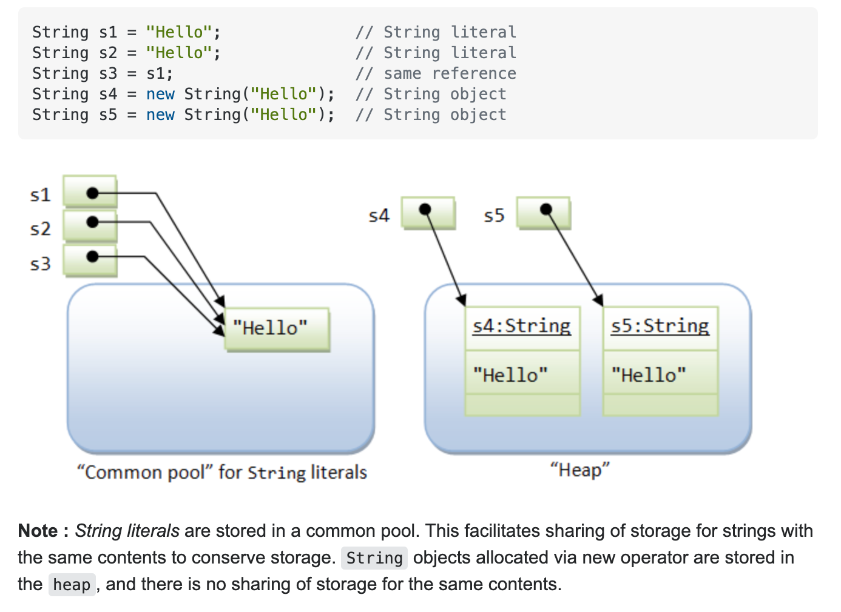
JAVA STRINGS

Slide 32
One more time!!!
Strings are objects…
Careful with == and equals!
DO NOT use == with Strings!
compareTo and equals ARE defined for strings!
Look at the API!

Slide 33
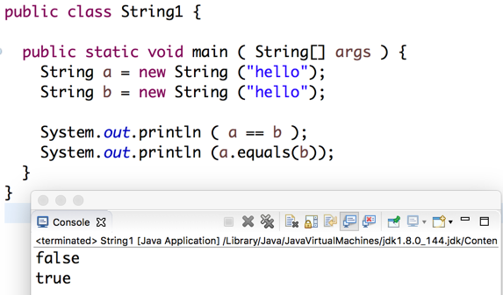
NOTE: two memory locations were allocated with new
Are a and b referencing the same memory location?
Are the values of the two strings equal?

Slide 34
Useful escape sequences
\"
\\
\n
\'
\t

Slide 35
More concatenation
int i = 0;
System.out.println("item #" + i +" is good");
item #0 is good
System.out.println("item #" + i+1 +" is good");
item #01 is good
System.out.println("item #" + (i+1) +" is good");
item #1 is good

Slide 36
What about chars?????
charAt useful String method
for (int i = 0; i < s.length(); i++) {
if (s.charAt(i)== ch){
System.out.println(ch + " found in position " + i + " of " + s);
}
}

Slide 37
Well…………
How are we doing?
PROBLEMS INVOLVING STRINGS!

Slide 38
Write a Java method that returns true if its String parameter is a palindrome (reads the same forward and in reverse), false otherwise.
Algorithm 1: Write a method reverseString that will return a String that is the reverse of it's String parameter.
ReverseString("cheat") would return the String "teach"
ReverseString("level") would return the String "level"
The method isPalindrome returns true if the original String has the same value as the reversed String.
isPalindrome ("cheat") returns false;
isPalindrome ("level") returns true

Slide 39
Write a Java method that returns true if its String parameter is a palindrome (reads the same forward and in reverse), false otherwise
Algorithm 2:
L E V E L
isPalindrome2 will return true if each pair has identical letters, false otherwise.
Try to be efficient in writing this algorithm.

Slide 40
/*
* Checks if string is a palindrome by pairing letters..
* last letter with first...etc. if not the same, return
* false.
* if all pairs the same, return true
*/
public static boolean isPalindrome2(String s) {
return true;
}

Slide 41
Oh no!!! What about this same algorithm written RECURSIVELY!!!!!
Algorithm 3:
L E V E L
isPalindromeRec will return true if each pair has identical letters, false otherwise.
Try to be efficient in writing this algorithm.

Slide 42
Oh no!!! What about this same algorithm written RECURSIVELY!!!!!
Algorithm 3:
L E V E L
What is the end condition? When do you stop?
How do you take ONE step?
Does each step take you closer to the end condition?

Slide 43
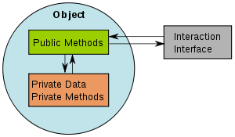
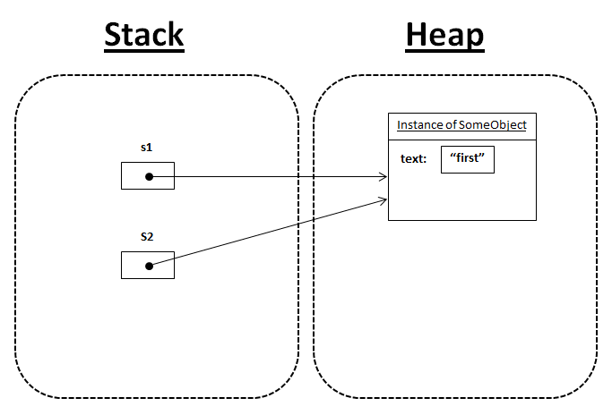
Objects and References
Distinguish between object and reference.
LO 9.1b
An object is an instance of a class that is created by using the “new” constructor.
The reference to an object is location
information to the actual object stored
in stack. The actual object is stored in
heap.
This Photo by Unknown Author is licensed under CC BY-SA

Slide 44
String ADT
Write code that manipulates/processes Strings by calling String methods.
LO 9.1e
A String is a sequence of Unicode characters.
defined in terms of its ADT values (typical)
public class String
String(String s) | create a string with the same value
int length() | string length
char charAt(int i) | ith character
String substring(int i, int j) | ith through (j-1)st characters
boolean contains(String sub) | does string contain sub?
boolean startsWith(String pre) | does string start with pre?
boolean endsWith(String post) | does string end with post?
int indexOf(String p) | index of first occurrence of p
int indexOf(String p, int i) | index of first occurrence of p after i
String concat(String t) | this string with t appended
int compareTo(String t) | string comparison
String replaceAll(String a, String b) | result of changing as to bs
String[] split(String delim) | strings between occurrences of delim
boolean equals(Object t) | is this string's value the same as t's ?
Java's ADT allows us to write Java programs that manipulate strings.
Operations (API)

Slide 45
Programming with strings: typical examples
Write code that manipulates/processes Strings by calling String methods.
LO 9.1e
public static boolean isPalindrome(String s)
{
int N = s.length();
for (int i = 0; i < N/2; i++)
if (s.charAt(i) != s.charAt(N-1-i))
return false;
return true;
}
String query = args[0];
while (!StdIn.isEmpty())
{
String s = StdIn.readLine();
if (s.contains(query))
StdOut.println(s);
}
Is the string a palindrome?
Find lines containing a specified string in StdIn
while (!StdIn.isEmpty())
{
String s = StdIn.readString();
if (s.startsWith("http://") && s.endsWith(".edu"))
StdOut.println(s);
}
String query = args[0];
while (!StdIn.isEmpty()) { String s = StdIn.readLine(); if (s.contains(query)) StdOut.println(s); }
Search for *.edu hyperlinks in the text file on StdIn
Find occurrences of a specified string in StdIn

Slide 46
String client example: gene finding
Use the concepts of Object-Oriented Programming (classes, objects, and methods) to write a program that solves a problem.
LO 9.1i
Pre-genomics era. Sequence a human genome.
Post-genomics era. Analyze the data and understand structure.
Genomics. Represent genome as a string over A C T G alphabet.
Gene. A substring of genome that represents a functional unit.
Made of codons (three A C T G nucleotides).
Preceded by ATG (start codon).
Succeeded by TAG, TAA, or TGA (stop codon).
0 | 1 | 2 | 3 | 4 | 5 | 6 | 7 | 8 | 9 | 10 | 11 | 12 | 13 | 14 | 15 | 16 | 17 | 18 | 19 | 20 | 21 | 22 | 23 | 24 | 25 | 26 | 27 | 28 | 29 | 30 | 31 | 32
A | T | A | G | A | T | G | C | A | T | A | G | C | G | C | A | T | A | G | C | T | A | G | A | T | G | T | G | C | T | A | G | C
0 | 1 | 2 | 3 | 4 | 5 | 6 | 7 | 8 | 9 | 10 | 11 | 12 | 13 | 14 | 15 | 16 | 17 | 18 | 19 | 20 | 21 | 22 | 23 | 24 | 25 | 26 | 27 | 28 | 29 | 30 | 31 | 32
A | T | A | G | A | T | G | C | A | T | A | G | C | G | C | A | T | A | G | C | T | A | G | A | T | G | T | G | C | T | A | G | C
start
gene
stop
start
gene
stop
Goal. Write a Java program to find genes in a given genome.

Slide 47
String client warmup: Identifying a potential gene
Goal. Write a Java program to determine whether a given string is a potential gene.
public class Gene
{
public static boolean isPotentialGene(String dna)
{
if (dna.length() % 3 != 0) return false;
if (!dna.startsWith("ATG")) return false;
for (int i = 0; i < dna.length() - 3; i+=3)
{
String codon = dna.substring(i, i+3);
if (codon.equals("TAA")) return false;
if (codon.equals("TAG")) return false;
if (codon.equals("TGA")) return false;
}
if (dna.endsWith("TAA")) return true;
if (dna.endsWith("TAG")) return true;
if (dna.endsWith("TGA")) return true;
return false;
}
public static void main(String[] args)
{
StdOut.println(isPotentialGene(args[0]));
}
}
0 | 1 | 2 | 3 | 4 | 5 | 6 | 7 | 8 | 9 | 10 | 11 | 12 | 13 | 14
A | T | G | C | A | T | A | G | C | G | C | A | T | A | G
start
gene
stop
% java Gene ATGCATAGCGCATAG
true
% java Gene ATGCGCTGCGTCTGTACTAG
false
% java Gene ATGCCGTGACGTCTGTACTAG
false

Slide 48
String client exercise: Gene finding
Goal. Write a Java program to find genes in a given genome.
0 | 1 | 2 | 3 | 4 | 5 | 6 | 7 | 8 | 9 | 10 | 11 | 12 | 13 | 14 | 15 | 16 | 17 | 18 | 19 | 20 | 21 | 22 | 23 | 24 | 25 | 26 | 27 | 28 | 29 | 30 | 31 | 32
A | T | A | G | A | T | G | C | A | T | A | G | C | G | C | A | T | A | G | C | T | A | G | A | T | G | T | G | C | T | A | G | C
0 | 1 | 2 | 3 | 4 | 5 | 6 | 7 | 8 | 9 | 10 | 11 | 12 | 13 | 14 | 15 | 16 | 17 | 18 | 19 | 20 | 21 | 22 | 23 | 24 | 25 | 26 | 27 | 28 | 29 | 30 | 31 | 32
A | T | A | G | A | T | G | C | A | T | A | G | C | G | C | A | T | A | G | C | T | A | G | A | T | G | T | G | C | T | A | G | C
start
gene
stop
start
gene
stop
Algorithm. Scan left-to-right through dna.
If start codon ATG found, set beg to index i.
If stop codon found and substring length is a multiple of 3, print gene and reset beg to -1.
i | codon |  | beg | output | remainder of input string
 | start | stop
0 |  |  | -1 |  | ATAGATGCATAGCGCATAGCTAGATGTGCTAGC
1 |  | TAG | -1 |  | TAGATGCATAGCGCATAGCTAGATGTGCTAGC
4 | ATG |  | 4 |  | ATGCATAGCGCATAGCTAGATGTGCTAGC
9 |  | TAG | 4 |  | TAGCGCATAGCTAGATGTGCTAGC
16 |  | TAG | 4 | CATAGCGCA | TAGCTAGATGTGCTAGC
20 |  | TAG | -1 |  | TAGATGTGCTAGC
23 | ATG |  | 23 |  | ATGTGCTAGC
29 |  | TAG | 23 | TGC | TAGC
Implementation. Entertaining programming exercise!

Slide 49
OOP context for strings
Possible memory representation of
String genome = "aacaagtttacaagc";
String s = genome.substring(1, 5);
String t = genome.substring(9, 13);
x
genome
t
s
aacaagtttacaagc
 |  |  |  |  |  |  |  |  |  |  |  |  |  |  |  |  |  |  |  |  |  |  |  |  |  |  | x | 15 |  |  |  |  |  |  |  | x+9 | 4 |  |  |  |  |  |  |  |  |  |  |  |  |  |  | x+1 | 4
memory
address
length
Implications
s and t are different strings that share the same value "acaa".
(s == t) is false (because it compares addresses).
(s.equals(t)) is true (because it compares character sequences).
Java String interface is more complicated than the API.

Slide 50
Object-oriented programming: summary
Object-oriented programming.
Create your own data types (sets of values and ops on them).
Use them in your programs (manipulate objects).
An object holds a data type value.
Variable names refer to objects.
In Java, programs manipulate references to objects.
String, arrays, (and everything else) are reference types.
Exceptions: boolean, int, double and other primitive types.
OOP purist: Languages should not have separate primitive types.
Practical programmer: Primitive types provide needed efficiency.
This lecture: You can write programs to manipulate sounds, colors, pictures, and strings.
Next lecture: You can define your own abstractions and write programs that manipulate them.

Slide 51
Pop quiz on ADTs
Explain the meaning of data type.
LO 9.1a
Q. What is a data type?
A. A set of values and a set of operations on those values.
Q. What is an abstract data type?

Slide 52
Pop quiz on ADTs
Q. What is a data type?
A. A set of values and a set of operations on those values.
Q. What is an abstract data type?
A. A data type whose representation is hidden from the client.

Slide 53
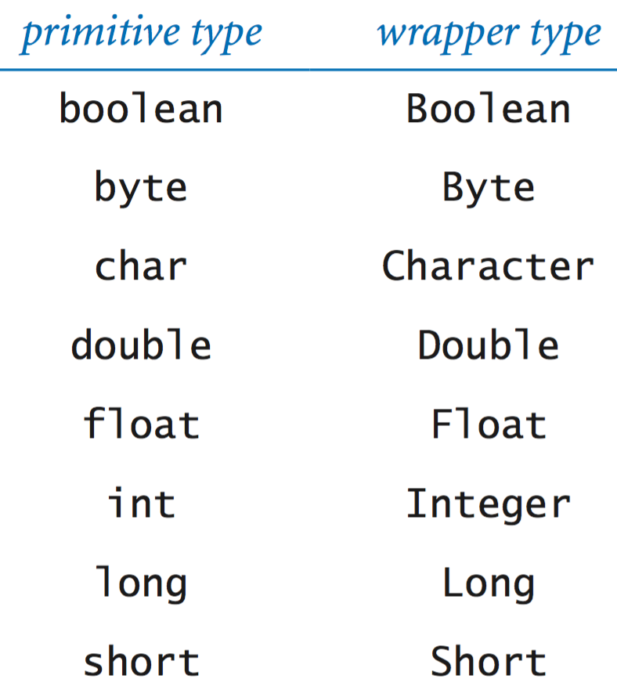
Primitive data type versus object reference
Distinguish between primitive data types and object references.
LO 9.1c
Q. What is a primitive data type?
A. A set primitive values (int, double, char, ..) that are not abstract data types.
Q. What is an object reference?
A. A reference to the object but not the internal details of the object.
Java provides object types for all primitive types

Slide 54
Image sources
http://upload.wikimedia.org/wikipedia/commons/6/6a/ Construction_Site_for_The_Oaks_High_School_Retford_-_geograph.org.uk_-_89555.jpg
Image sources
http://archive.hudsonalpha.org/education/outreach/basics/eye-color
http://www.designishistory.com/1940/joseph-albers/
http://en.wikipedia.org/wiki/Josef_Albers#mediaviewer/File:Josef_Albers.jpg
http://fr.freepik.com/photos-libre/oeil-au-beurre-noir-et-blanc_620699.htm
http://en.wikipedia.org/wiki/The_Treachery_of_Images#mediaviewer/File:MagrittePipe.jpg
http://static.tvtropes.org/pmwiki/pub/images/not-a-pipe-piraro_598.png

Slide 55
9. Abstract Data Types
Overview
String processing

Slide 56
9. Abstract Data Types
1.1–1.2

